Slide 1


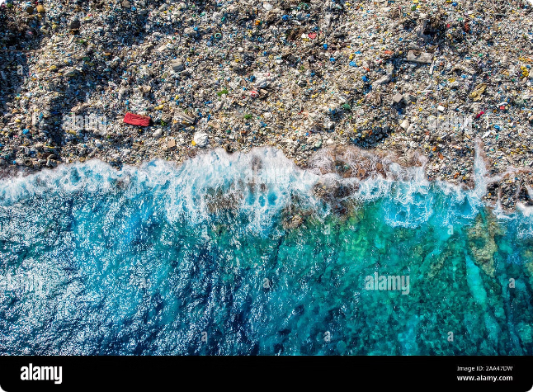


Introduction to Pollution
Pollution is the contamination of the environment by harmful substances. It can be caused by a variety of human activities, including industrial processes, agriculture, and transportation.
by DUDEKULA DASTAGIRI

Slide 2

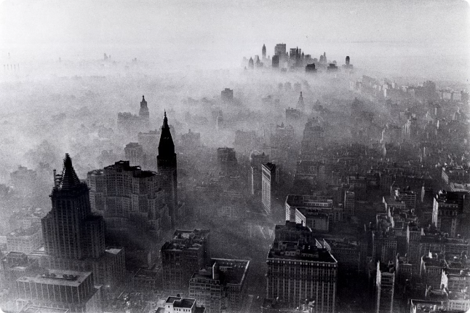
Types of Pollution
1
Air Pollution
2
Water Pollution
Air pollution is the contamination of the atmosphere by harmful gases, particulate matter, and other pollutants.
Water pollution is the contamination of water bodies, such as rivers, lakes, and oceans, by pollutants that can harm aquatic life and human health.
3
Soil Pollution
4
Noise Pollution
Soil pollution is the contamination of soil by pollutants, such as pesticides, herbicides, and heavy metals.
Noise pollution is the excessive or unwanted sound that can have negative effects on human health and well-being.

Slide 3
Causes of Pollution
Industrial Activities
Agriculture
Transportation
Industrial processes often release harmful pollutants into the air, water, and soil. These can include chemicals, heavy metals, and greenhouse gases.
Agricultural practices, such as the use of pesticides and fertilizers, can contribute to soil, water, and air pollution.
Vehicles, particularly cars and trucks, release pollutants such as carbon monoxide, nitrogen oxides, and particulate matter.

Slide 4
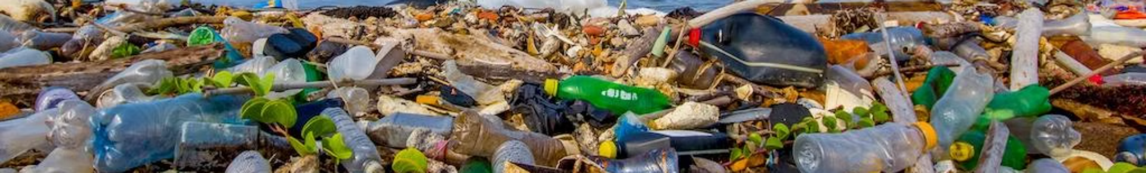



Effects of Pollution on the Environment
Climate Change
Greenhouse gases, released by human activities, trap heat in the atmosphere, contributing to global warming and climate change.
Biodiversity Loss
Pollution can harm or kill plants and animals, reducing biodiversity and disrupting ecosystems.
Habitat Degradation
Pollutants can contaminate and degrade habitats, making them unsuitable for the species that rely on them.

Slide 5


Effects of Pollution on Human Health
Respiratory Problems
Air pollution can cause asthma, bronchitis, and other respiratory illnesses.
Cardiovascular Disease
Exposure to air pollution has been linked to an increased risk of heart disease and stroke.
Cancer
Some pollutants, such as benzene and formaldehyde, are known carcinogens.
Neurological Disorders
Exposure to certain pollutants, such as lead and mercury, can damage the nervous system.

Slide 6

Strategies to Reduce Pollution
Reduce Consumption
1
Consume less energy, water, and materials. Choose products made with recycled materials or that are biodegradable.
2
Adopt Sustainable Practices
Use public transportation, walk, or bike instead of driving. Reduce, reuse, and recycle whenever possible.
Support Environmental Policies
3
Advocate for stricter environmental regulations and policies that promote clean energy and sustainable practices.

Slide 7






Role of Government and Policymakers
Enforce Regulations
Invest in Clean Technologies
Implement and enforce strict environmental regulations to limit pollution from industries, transportation, and other sources.
Invest in research and development of clean technologies, such as renewable energy sources and pollution control systems.
Promote Public Awareness
International Cooperation
Educate the public about the importance of environmental protection and encourage responsible behavior.
Collaborate with other countries to address transboundary pollution and climate change.

Slide 8


Conclusion and Call to Action
Pollution is a serious threat to our planet and our health. By understanding the causes and effects of pollution, we can take action to reduce our impact on the environment. We all have a role to play in protecting our planet for future generations. Let's work together to create a cleaner, healthier world.

